Slide 1
Schematic Diagram: IoT based Garage Door Opener
Group 4
Shivinder Kaur
C0751078

Slide 2
Content:
Introduction
Tools Required
Schematic Diagram
Project Schematic
Conclusion
Reference

Slide 3
Introduction:
Schematic capture is the process of creating a schematic diagram for an electronic circuit using various tools designed for the job.
It is also known as wiring diagram or circuit diagram.
This can be done from as simple as using a pen and paper to using schematic capture software.
It is a process of designing a circuit that will serve a specific purpose by making use of industry standards and conventions to put the design into a visual state, either via hand drawing or by entering it into a software made for the purpose.

Slide 4
Introduction:
It can be seen in the same manner as a digital artist might draw using a tool like Photoshop or a writer using a word processor.
In these schematic diagram, we represent actual wiring of the components and represent the proper functioning of the components.
We also able to know what pins we have to use from our main controller.
Example of Schematic Diagram Software: EASY EDA, Fritzing, Proteus, KiCAD EDA, circuit lab etc.

Slide 5
Tools Required:
Software Installed: EasyEDA
Components used:
Main Processing Unit (BBB) - Primary Device
Arduino - Secondary Device
IR Sensor
GSM Module
Keypad and LCD
ESP 32
L298 Motor Driver and DC gear motor
Buzzer and Push button

Slide 6
EasyEDA
For designing our project schematic diagram, we are using EASYEDA schematic diagram software.
EasyEDA is a free open source software which is easy to use and understand.
EasyEDA is a web based Electronic Design Automation tool (EDA). we can use it in browser or also download it software.
The software is compatible with Linux OS, Windows OS and MacOS.
EasyEDA has all the features that we expect and easily take our design from conception through to production.

Slide 7
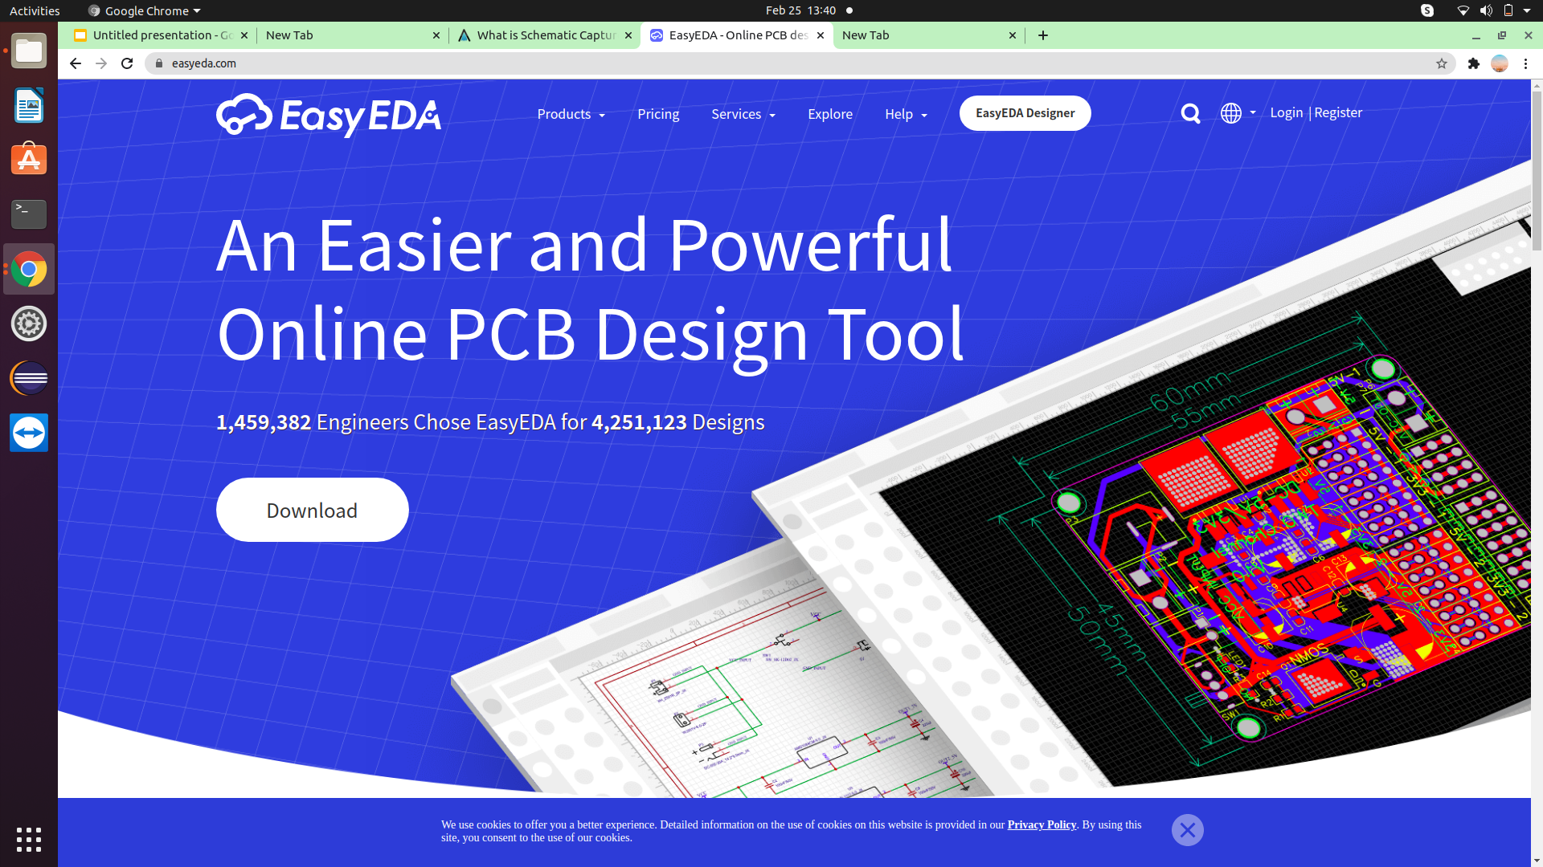
EasyEDA

Slide 8
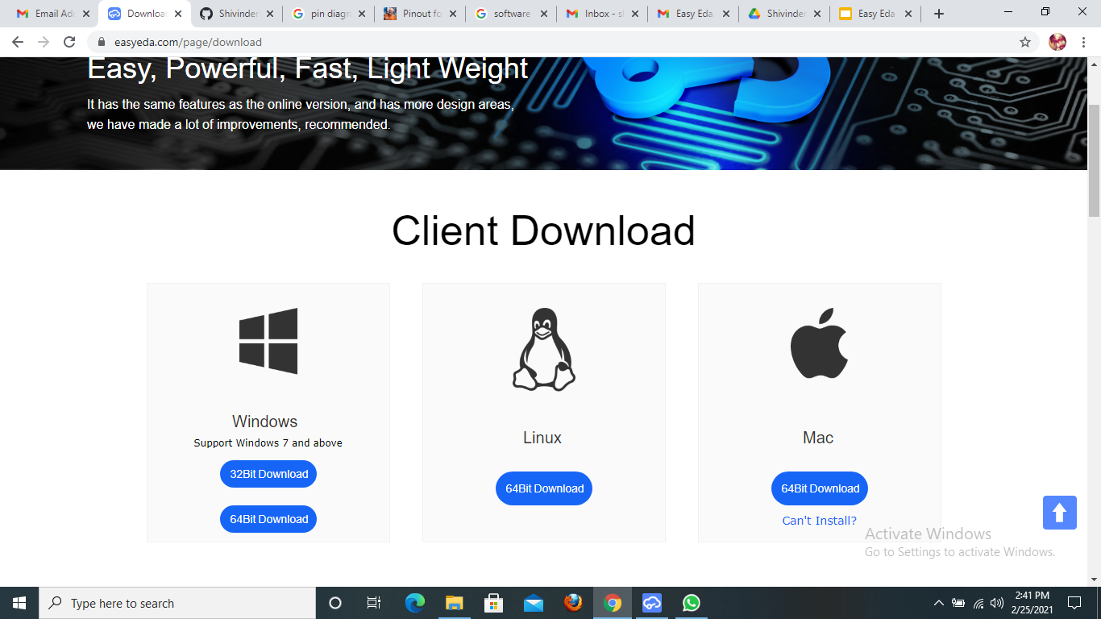
EasyEDA

Slide 9
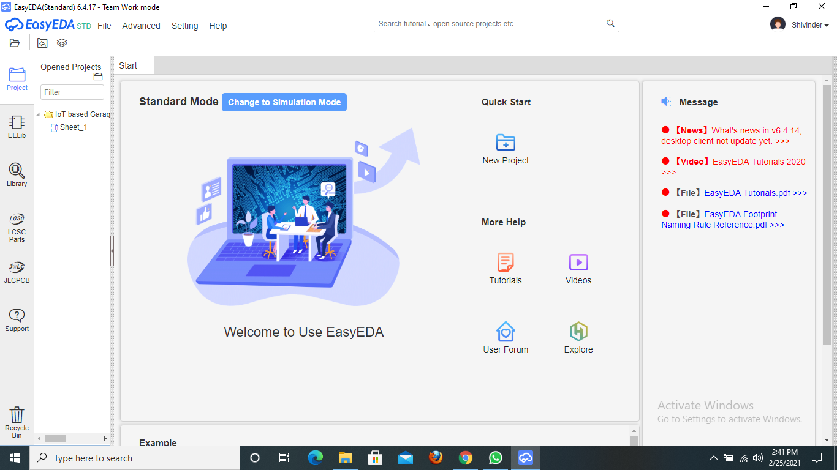
EasyEDA

Slide 10
EasyEDA
Navigation Panel
Displays all the existing projects

Slide 11
EasyEDA
All the basic existing components like power supply, ground and other can be found here.

Slide 12
EasyEDA
We can easily search any component from here and import it to the schematic diagram.

Slide 13
EasyEDA
These two options take you to the external website if you wish to order any component.

Slide 14
EasyEDA
We can start our new project by clicking here.

Slide 15
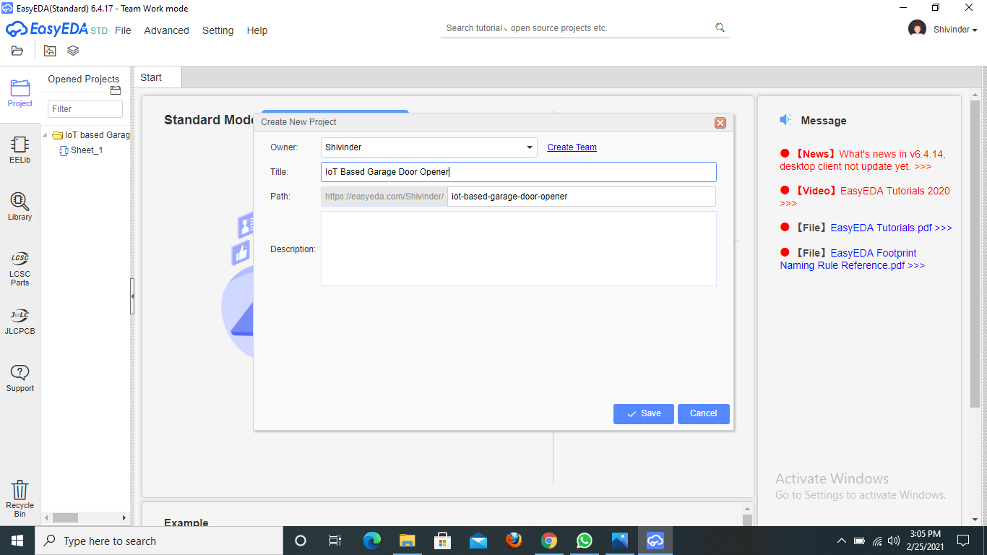
EasyEDA
Here we can give the title to our project.

Slide 16
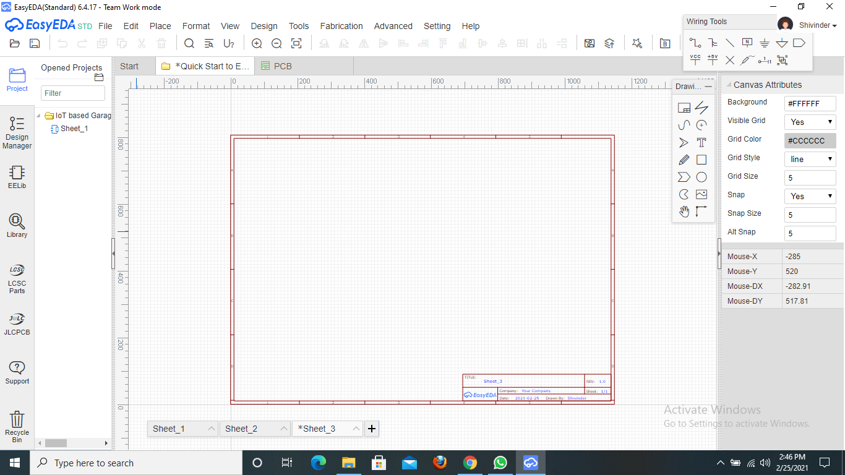
EasyEDA
After creating a project then this sheet window will appear where we can create our schematic diagram.

Slide 17
EasyEDA
Menu Bar

Slide 18
EasyEDA
All the components that we will use in the project would be here along with their pin description.

Slide 19
EasyEDA
These are the wiring tools that we can use while connecting the components with each other.

Slide 20
EasyEDA
This is the attribute column where we can change names, colour, style, size or etc. about the board.

Slide 21
EasyEDA
Drawing Sheet Information

Slide 22
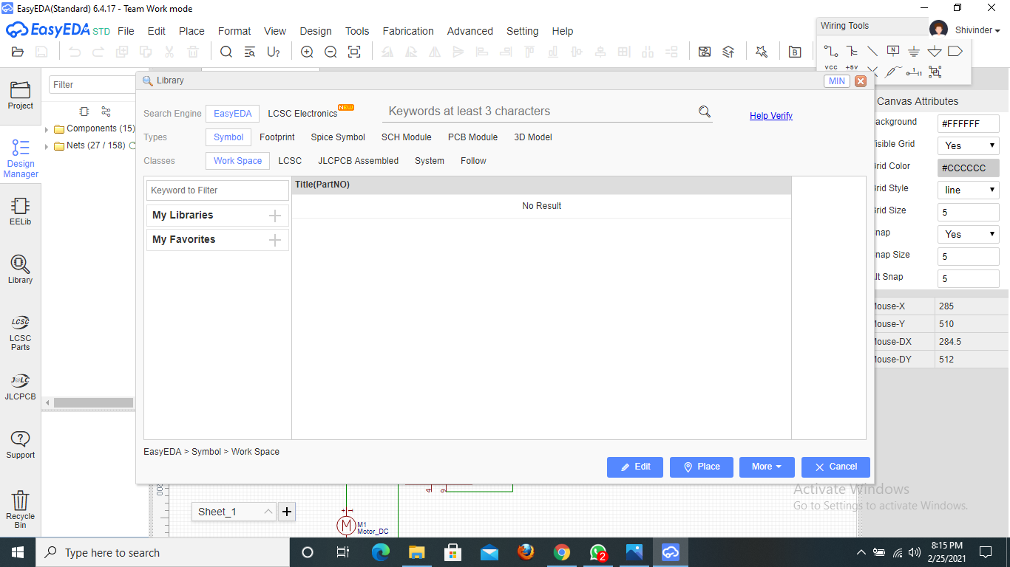
EasyEDA
We can type the component name tha we want to use.

Slide 23
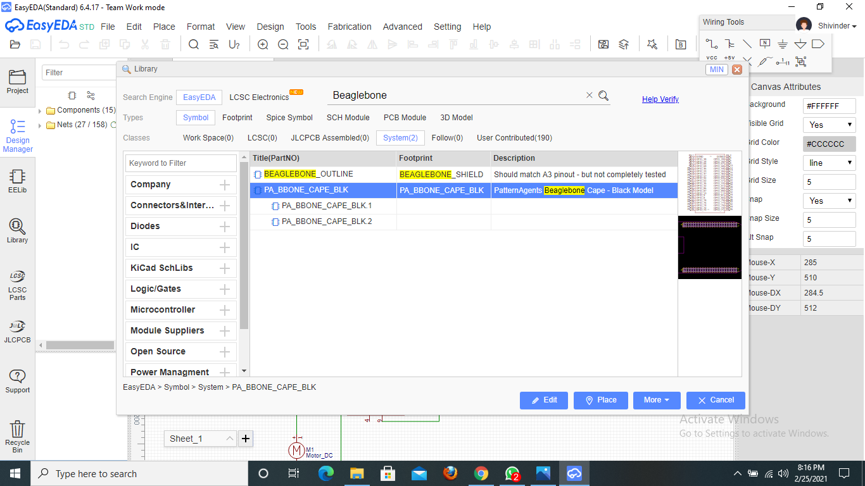
EasyEDA
When we search the component then the search result will appear as shown in the picture and we can select it by clicking on place and can place it on our sheet.
So, here for the example I have chosen Beaglebone Black; similarly I searched all the components that we required for our project and placed them on the sheet.

Slide 24
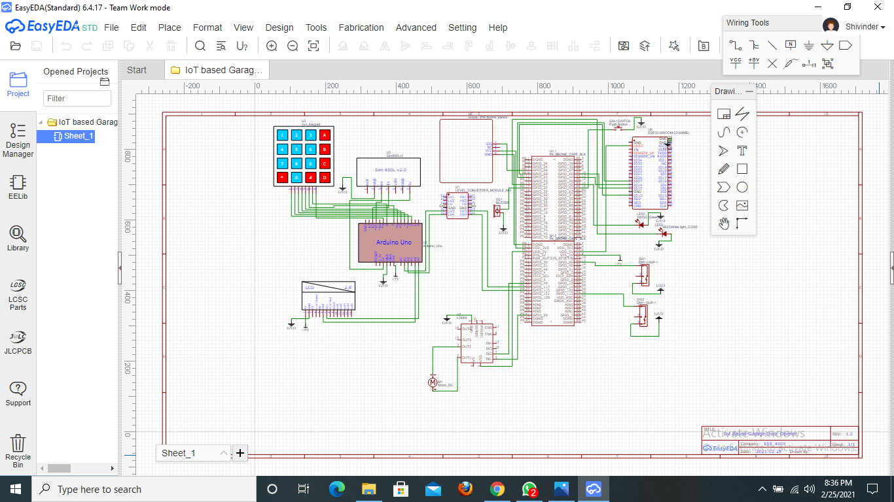
Schematic Diagram

Slide 25
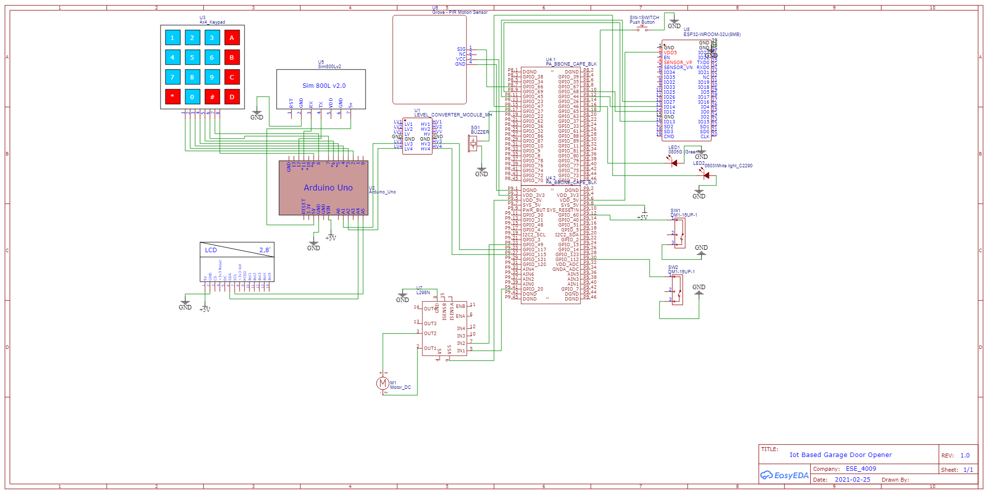
Schematic Diagram

Slide 26
Schematic Connections
First we connected the Logic Level Converter to BeagleboneBlack.
Beaglebone Black | Logic Level Converter
P9.25 (GPIO 117) | HV3
P9.27(GPIO 115) | HV4

Slide 27
Schematic Connections
Then we connected the LV side of Logic Level Converter to Arduino Uno.
Arduino Uno | Logic Level Converter
A1 | LV3
A2 | LV4

Slide 28
Schematic Connections
Here are the connections of Arduino Uno to LCD Display and Keypad.
Arduino Uno | Keypad
D2 | 1
D3 | 2
D4 | 3
D5 | 4
D6 | 5
D7 | 6
D8 | 7
D9 | 8

Slide 29
Schematic Connections
Here are the connections of Arduino Uno to LCD Display and Keypad.
Arduino Uno | LCD Display
A4 | SDA
A5 | SCL
5v | 5v
GND | GND

Slide 30
Schematic Connections
Arduino Uno and GSM SIM800L connections.
Arduino Uno | GSM SIM800L
D12 | Tx
D11 | Rx
5v | 5v
GND | GND

Slide 31
Schematic Connections
Beaglebone Black and PIR Sensor connections.
PIR Sensor | Beaglebone Black
SIG/OUT | GPIO_66 (P8.7)
VCC | 3V
GND | GND

Slide 32
Schematic Connections
Beaglebone Black and ESP32 Wifi Module connections.
ESP32 wifi module | Beaglebone Black
D12 | GPIO_68(P8.10)
D13 | GPIO_69(P8.9)
D14 | GPIO_44(P8.12)
D27 | GPIO_45(P8.11)
5V | 5V
GND | GND

Slide 33
Schematic Connections
Beaglebone Black and Motor Driver connections.
Motor Driver L298N | Beaglebone Black
IN1 | GPIO_20 (P9.41)
IN2 | GPIO_49(P9.23)
5V | 5V (P9.5)
GND | GND

Slide 34
Schematic Connections
Motor Driver and Motor connections.
Motor Driver L298N | Motor
OUT1 | 2
OUT2 | 1

Slide 35
Schematic Connections
Beaglebone Black and Limit Switch
Limit switch | Beaglebone Black
LM1 | GPIO_60(P9.12)
LM2 | GPIO_112(P9.30)
GND | GND

Slide 36
Schematic Connections
Beaglebone Black and LED
LED | Beaglebone Black
White LED | GPIO_47(P8.15)
Green LED | GPIO_46(P8.16)
GND Red Led | GND
GND Green LED | GND

Slide 37
Schematic Connections
Beaglebone Black and Buzzer
Buzzer | Beaglebone Black
Positive | GPIO_27(P8.17)
GND | GND

Slide 38
Schematic Connections
Beaglebone Black and Push button
Push Button | Beaglebone Black
Positive | GPIO_65(P8.18)
GND | GND

Slide 39
Reference
Retrieved from techopedia, URL: https://www.techopedia.com/definition/21935/schematic-capture
Retrieved from robotshop, URL: https://www.robotshop.com/community/forum/t/start-your-easy-eda-journey-on-the-free-circuit-design-software/4950
Retrieved from EasyEDA, URL: https://docs.easyeda.com/en/FAQ/Editor/index.html

